Slide 1


PyTorch-101: Introduction to
PyTorch

Slide 2
What is PyTorch?
PyTorch is a Python library which facilitate building deep learning models easily.
Used for applications such as computer vision and natural language processing, etc.
Developed by Facebook AI Research (FAIR) lab.
PyTorch emphasizes ﬂexibility and allows deep learning models to be expressed in idiomatic Python, which makes it a strong contender to replace TensorFlow as ﬁrst choice.
It allows you to work with NumPy-like arrays on GPUs.
PyTorch supports dynamic computation graph.
Helps in automatically computing gradients.

Slide 3
Why PyTorch?
TensorFlow has a steep learning curve, and is not “so Pythonic” to easily grasp.
Creating a static dynamic graph in TensorFlow beforehand is unnecessary. Instead, PyTorch allows creation of dynamic computation graph on the ﬂy!
PyTorch allows automated differentiation and gradient passing. (AutoGrad)
It is a replacement for NumPy to use the power of GPUs and other accelerators.

Slide 4
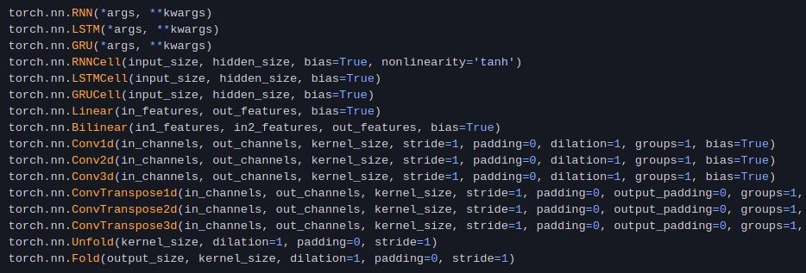
Diving into the library: NN Layers

Slide 5
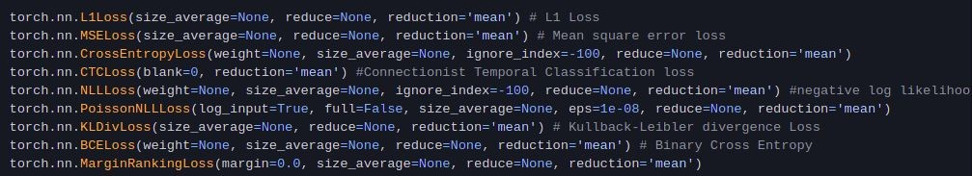
Diving into the library: Loss Functions

Slide 6
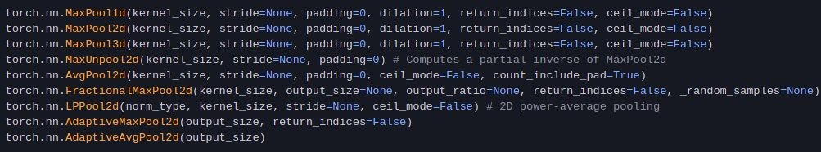
Diving into the library: Pooling Layers

Slide 7
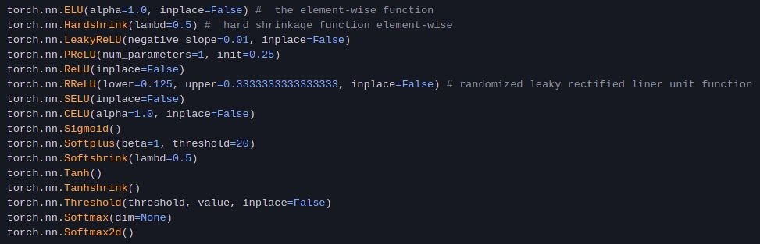
Diving into the library: Activation Functions

Slide 8
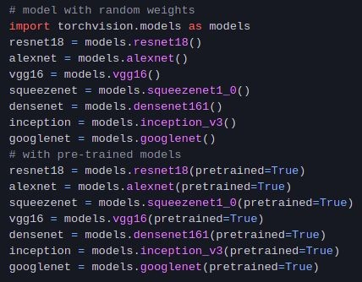
Diving into the library: Models

Slide 9
PyTorch sub-libraries for special tasks
Torchaudio: https://pytorch.org/audio/0.7.0/index.html
Torchtext: https://pytorch.org/text/stable/index.html
Torchvision: https://pytorch.org/vision/stable/index.html
TorchElastic: https://pytorch.org/elastic/0.2.2/index.html
TorchServe: https://pytorch.org/serve/
PyTorch for XLA devices: https://pytorch.org/xla/release/1.7/index.html
1. PyTorch Lightning: https://www.pytorchlightning.ai/

Slide 10
References you should use!
Ofﬁcial Website: https://pytorch.org
PyTorch Intro Tutorial: https://pytorch.org/tutorials/beginner/deep_learning_60min_blitz.html
Fast-PyTorch: https://github.com/omerbsezer/Fast-Pytorch
Ofﬁcial Documentation: https://pytorch.org/docs/stable/index.html
https://www.analyticsvidhya.com/blog/2019/09/introduction-to-pytorc h-from-scratch/

